Slide 1
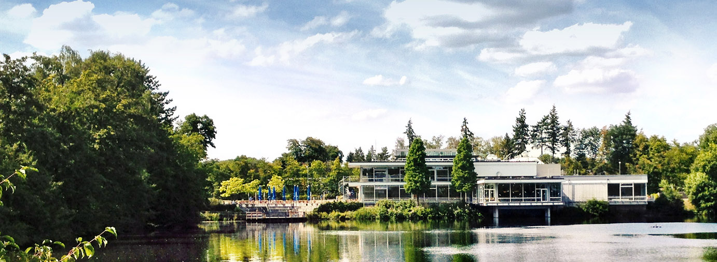



Deep learning for short-term temperature forecasts with video prediction methods
Bing Gong, Scarlet Stadtler, Michael Langguth, Amirpasha Mozaffari, Jan Vogelsang, Martin G. Schultz
I B.GONG@FZ-JUELICH.DE I 2020-05-06
EGU 2020: session ITS4.3/AS5.2 Machine learning for Earth System modelling

Slide 2
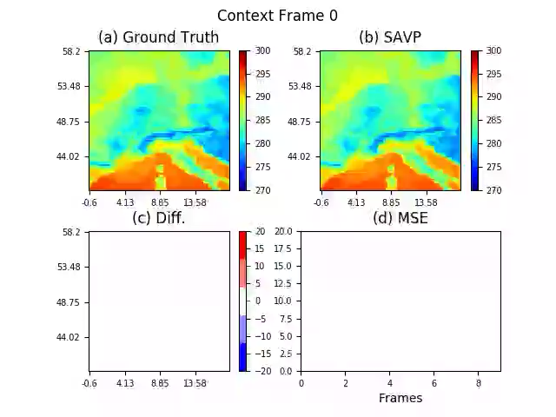




Abstract
2m temperature prediction
VIDEO PREDICTION
ALGORITHM
Predict
2 m T FORECAST
ERA5
Input
Extraction
2m T
GEOPOT
SLP
Over Europe
YEARS 2016, 2017
Pre-
processing
Click here to start video!
EVALUATION
Click to navigate to the corresponding section

Slide 3
outline
Motivation
Deep learning architectures
Parallel deep learning workflow
Experiment settings
Results
Conclusions and outlook
Hint: Click hyperlink to the corresponding section

Slide 4
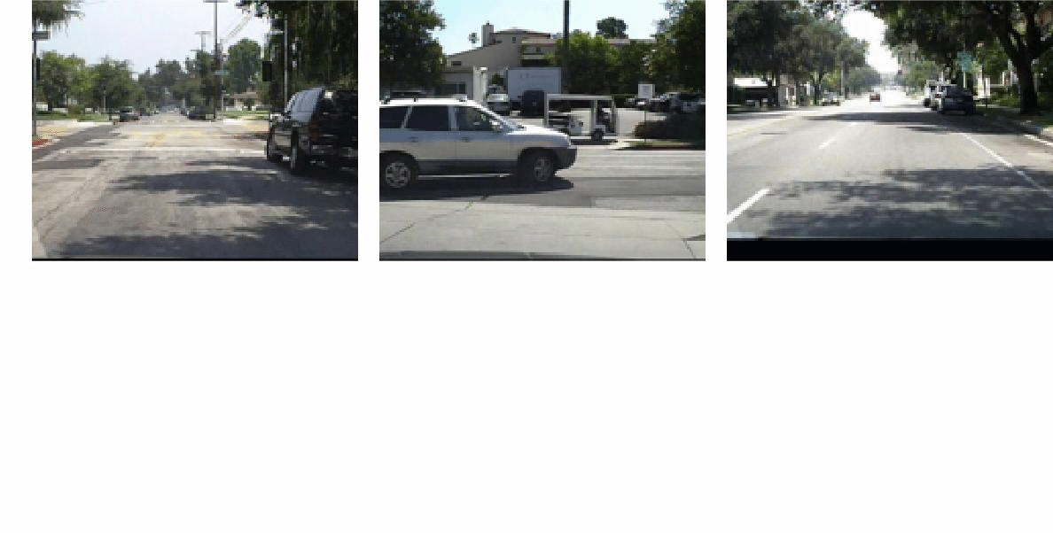
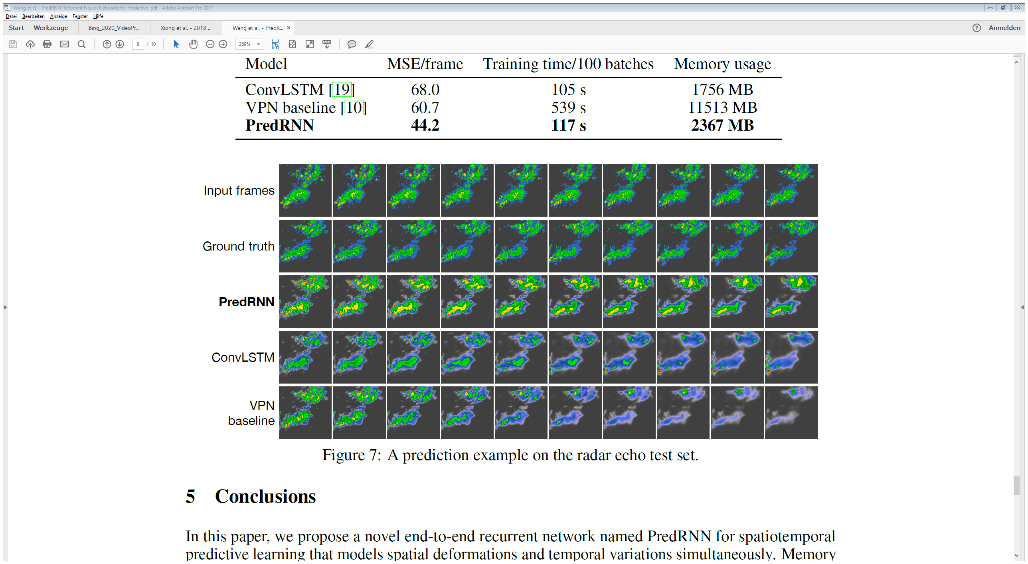
MOTIVATION
Video prediction → New data-driven approach for weather forecasting
Wang, Y et al. 2017
In computer vision, video prediction is an essential study area. It has been successfully applied in many applications such as human action prediction (Lee, Alex X. et al. 2018), self-driving cars (Lotter, William et al. 2016), etc.
There are certain similarities between the deep learning tasks of video prediction and weather forecasting: Explore spatio-temporal patterns from previously observed data to generate the future frames.

Slide 5
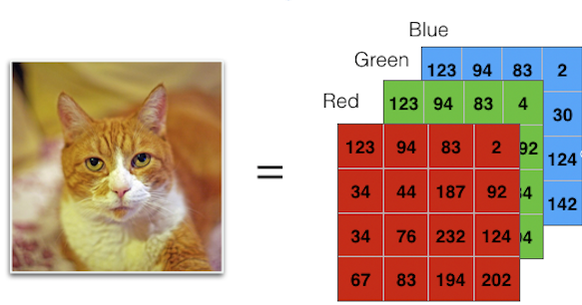
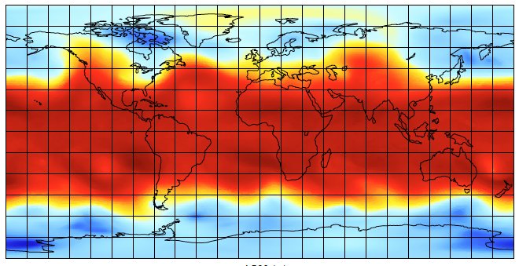
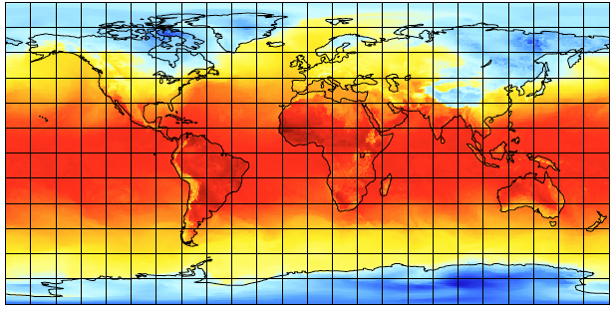
MOTIVATION
Video prediction → New data-driven approach for weather forecasting
The channels of images can be represented by different relevant variables for weather prediction.

Slide 6
MOTIVATION
Video prediction → New data-driven approach for weather forecasting
Big data in weather forecasting and advanced Deep Learning architecture → High-Performance Computing (HPC) & Parallelisation
Reproducibility → End-to-end workflow
Whenever a deluge of data has to be processed (like in video prediction and weather forecasting applications or for cutting-edge deep learning architectures with enormous parameters), parallel computing is necessary for accelerating the life-cycle of prediction.
For deep learning applications, the data and the selected architectures can change constantly for various experiment settings. Therefore, an end-to-end workflow ensures the reproducibility of these experiments.

Slide 7
outline
Motivation
Deep learning architectures
Parallel deep learning workflow
Experiment settings
Results
Conclusions and outlook

Slide 8
DEEP LEARNING ARCHITECTURES
State-of-the-art architectures for video prediction
RNN architecture (click for more details )
GAN architecture (click for more details)
The state-of-the-art methodologies for video prediction can be roughly categorized into three groups, Recurrent Neural Network (RNN), Variational Autoencoder (VAE), and Generative Adversarial Network (GAN) based model.
VAE architecture (click for more details)

Slide 9
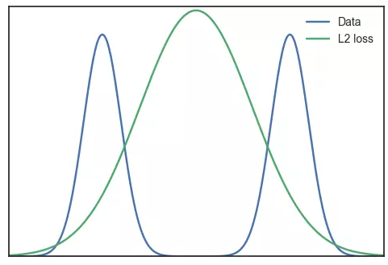
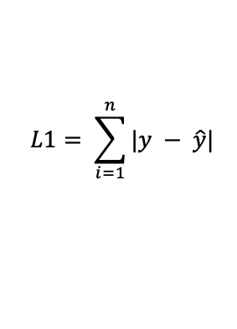
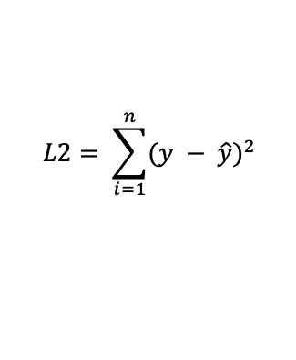
DEEP LEARNING ARCHITECTURES
Downsides of state-of-the-art architectures for video prediction
Problem 1: Unrealistic images
$$L2= \sum_{i=1}^{n}{{(y − \hat{y})}^{2}}$$
$$L1= \sum_{i=1}^{n}{|y − \hat{y}|}$$
Adversarial loss
$$ℒ_{GAN}\left(G,D\right)= Ε_{x_{1:T}}\left[logD\left(x_{1:T}\right)\right]+Ε_{x_{1:T, z\sim p(z_{t})|_{t=0}^{T−1}}}\left[log⁡(1−D\left(G(x_{0, }z_{0:T−1})\right))\right]$$
For RNN and VAE, if each pixel follows multi-modal distribution, then using L2 Norm or L1 Norm will average the loss function. It means to produce the mean of image of all possible futures, as the global optimum. This will produce unrealistic prediction images.

Slide 10
DEEP LEARNING ARCHITECTURES
Downsides of state-of-the-art architectures for video prediction
Problem 2: Mode collapse
Mode collapse
GAN based on adversarial learning can produce more realistic images than RNN and VAE with L2/L1 loss. On the downside, it potentially only produces a limited diversity of output (e.g. limited number of dog breeds), which is commonly called mode collapse.

Slide 11
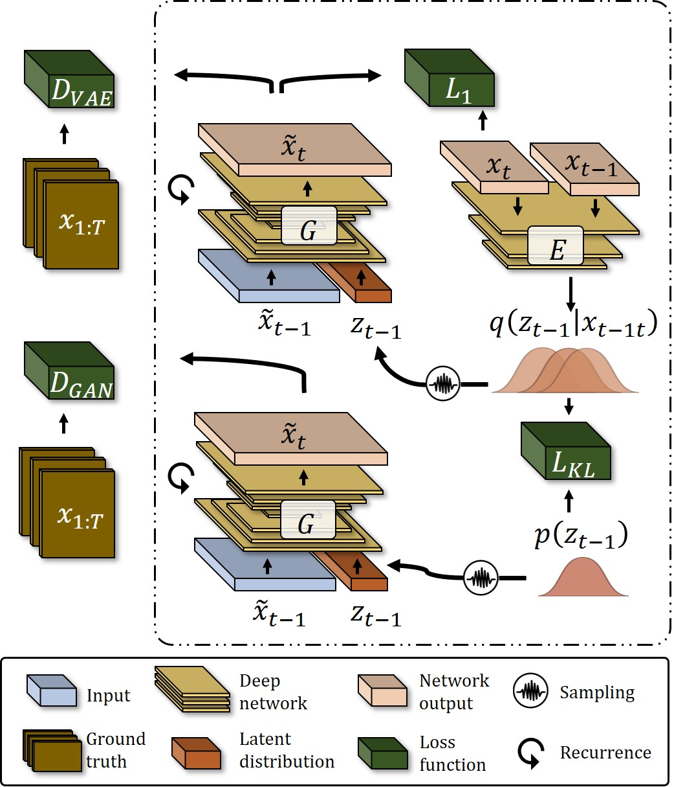
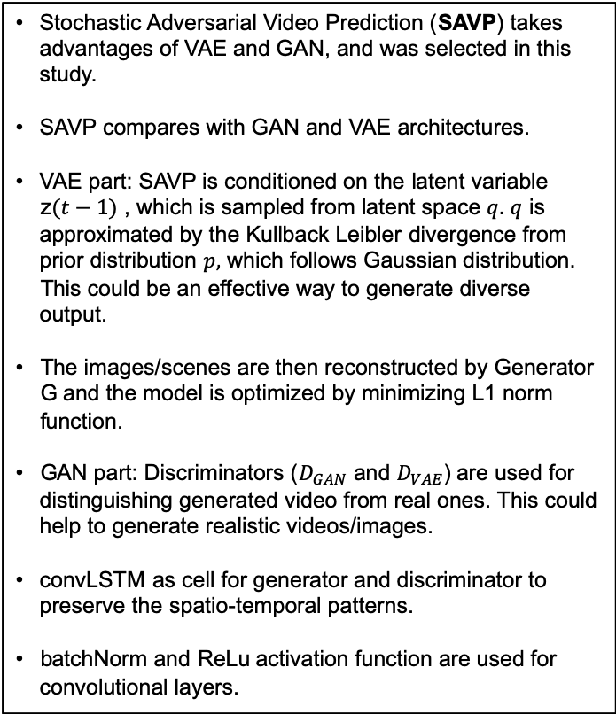
DEEP LEARNING ARCHITECTURES
Selected solution for weather forecasting
Stochastic Adversarial Video Prediction (SAVP) takes advantages of VAE and GAN, and was selected in this study.
SAVP compares with GAN and VAE architectures.
VAE part: SAVP is conditioned on the latent variable z$(t−1)$ , which is sampled from latent space $q.$ $q$ is approximated by the Kullback Leibler divergence from prior distribution $p,$ which follows Gaussian distribution. This could be an effective way to generate diverse output.
The images/scenes are then reconstructed by Generator G and the model is optimized by minimizing L1 norm function.
GAN part: Discriminators ($D_{GAN}$ and $D_{VAE}$) are used for distinguishing generated video from real ones. This could help to generate realistic videos/images.
convLSTM as cell for generator and discriminator to preserve the spatio-temporal patterns.
batchNorm and ReLu activation function are used for convolutional layers.
Lee et al. 2018
back

Slide 12
outline
Motivation
Deep learning architectures
Parallel deep learning workflow
Experiment settings
Results
Conclusions and outlook

Slide 13

Parallel deep learning workflow
Parallelization with Pystager and Horovod
Data
Extraction
Data
Pre-processing
Training
Post-processing
Pystager:
http://bit.ly/PyStager1
We have Pystager for data extraction and pre-processing, and Horovod (Sergeev, Alexander et al., 2018 ) for the last two steps.
Check scalability performance for training

Slide 14
outline
Motivation
Deep learning architectures
Parallel deep learning workflow
Experiment settings
Results
Conclusions and outlook

Slide 15

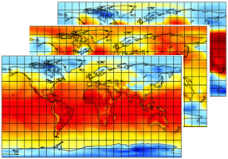
Experiment settings
Size: ~ 500 TB,
Grid points/Pixel: 601 * 1200
Time resolution: Hourly
Temperature forecasting
Data
Extraction
We adopt a case study as proof-of-concept for our proposed parallel deep learning workflow. This study aims to forecast 2m above sea level temperature. We take the era5 reanalysis data from ECMWF as data source.
Data
Pre-processing
ERA5 reanalysis data
Training
Post-processing
back

Slide 16
Experiment settings
Size: ~ 500 TB,
Grid points/Pixel: 601 * 1200
Time resolution: Hourly
Temperature forecasting
Data
Extraction
Size: ~ 2.2 TB
Time: 2016/2017
Region: Europe
Var:
2m Temperature
500hPa Geopotential
Sea level pressure
Data
Pre-processing
ERA5 reanalysis data
Training
We take 2016 and 2017 as our operational datasets along with different combinations of selected variables, based on which we conduct a series of experiments.
Post-processing
back

Slide 17
Experiment settings
Temperature forecasting
Forecasting the next 10 hours 2m temperature
Data
Extraction
Size: ~ 3300 MB
Samples: 64 * 64 * 3, 10 frames /sample as an input
Data
Pre-processing
Data splitting without shuffling
2016
Training
2017
Train
Val
Test
Post-processing
Each block corresponds to a month.
We partition the data into Training, validation and testing dataset, without shuffling.
back

Slide 18
Experiment settings
Experiment settings
No. | Years | Arc. | Variables | Mode
1 | 2017 | SAVP | 3 * Temperature | End-to-end
2 | 2017 | SAVP | Temperature, mean sea-level pressure, 500hPa geopotential | End-to-end
3 | 2016-2017 | SAVP | 3 * Temperature | End-to-end
4 | 2017 | SAVP | 3 * Temperature | KTH_pretrained
5 | 2017 | GAN | 3 * Temperature | End-to-end
6 | 2017 | GAN | Temperature, mean sea-level pressure, 500hPa geopotential | End-to-end
7 | 2016-2017 | GAN | 3 * Temperature | End-to-end
8 | 2017 | VAE | 3 * Temperature | KTH_pretrained
9 | 2017 | VAE | 3 * Temperature | End-to-end
10 | 2017 | VAE | 3 * Temperature | KTH_pretrained
Data
Extraction
Data
Pre-processing
Training
Post-processing
Note: More details about variables, mode selection
We conducted several experiments by varying dataset selected year, architectures, variables, and also training modes - pretrained or end-to-end learning.

Slide 19
outline
Motivation
Deep learning architectures
Parallel deep learning workflow
Experiment settings
Results
Conclusions and outlook

Slide 20
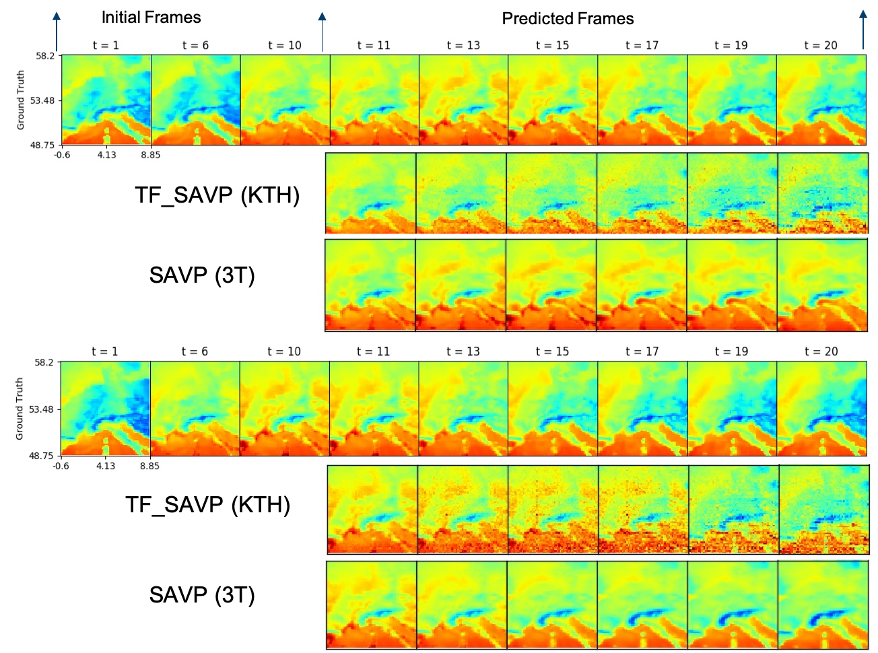
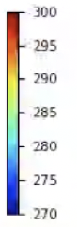
results
Transfer learning VS end-to-end learning
Data
Extraction
Figure. Visualization of two examples of ground truth (top row) and predicted
frames from experiments 4 (second row) and 1 (third row);values temperature are in Kelvin
Data
Pre-processing
Training
Post-processing
The results show that the pre-trained model generates noisy frames where the temperature is homogeneous over the Mediterranean sea. By contrast, the end-to-end trained model (experiment 1) tends to underestimate cooling over Central Europe.
back

Slide 21
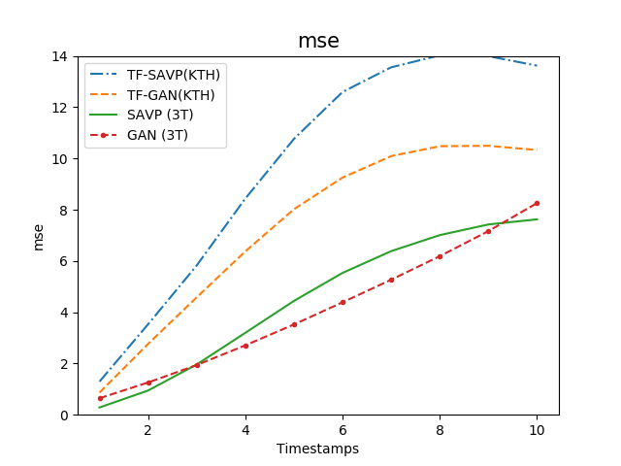
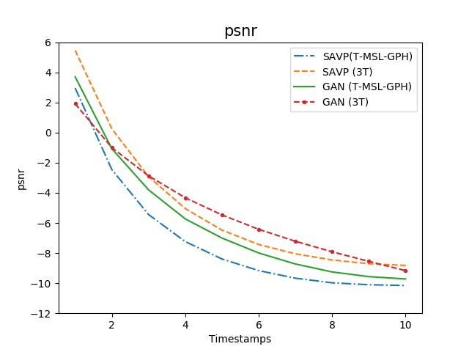
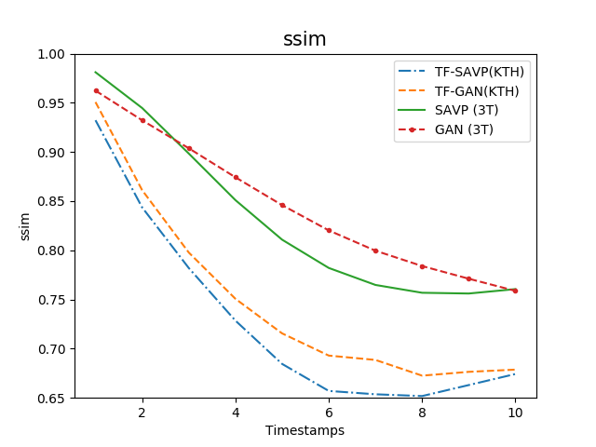
results
Transfer learning VS end-to-end learning
Data
Extraction
Data
Pre-processing
Training
Compares the forecast quality of the pre-trained experiments with the scores of the benchmark experiments with the three model architectures, showing In all cases, pre-training with the KTH dataset reduces the forecast skill of the models.
Post-processing
Evaluation metrics (SNR, SSIM, MSE and skill scores)
back

Slide 22
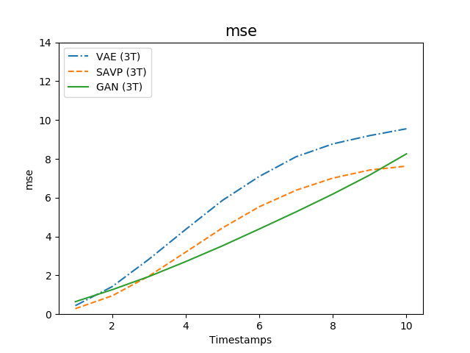
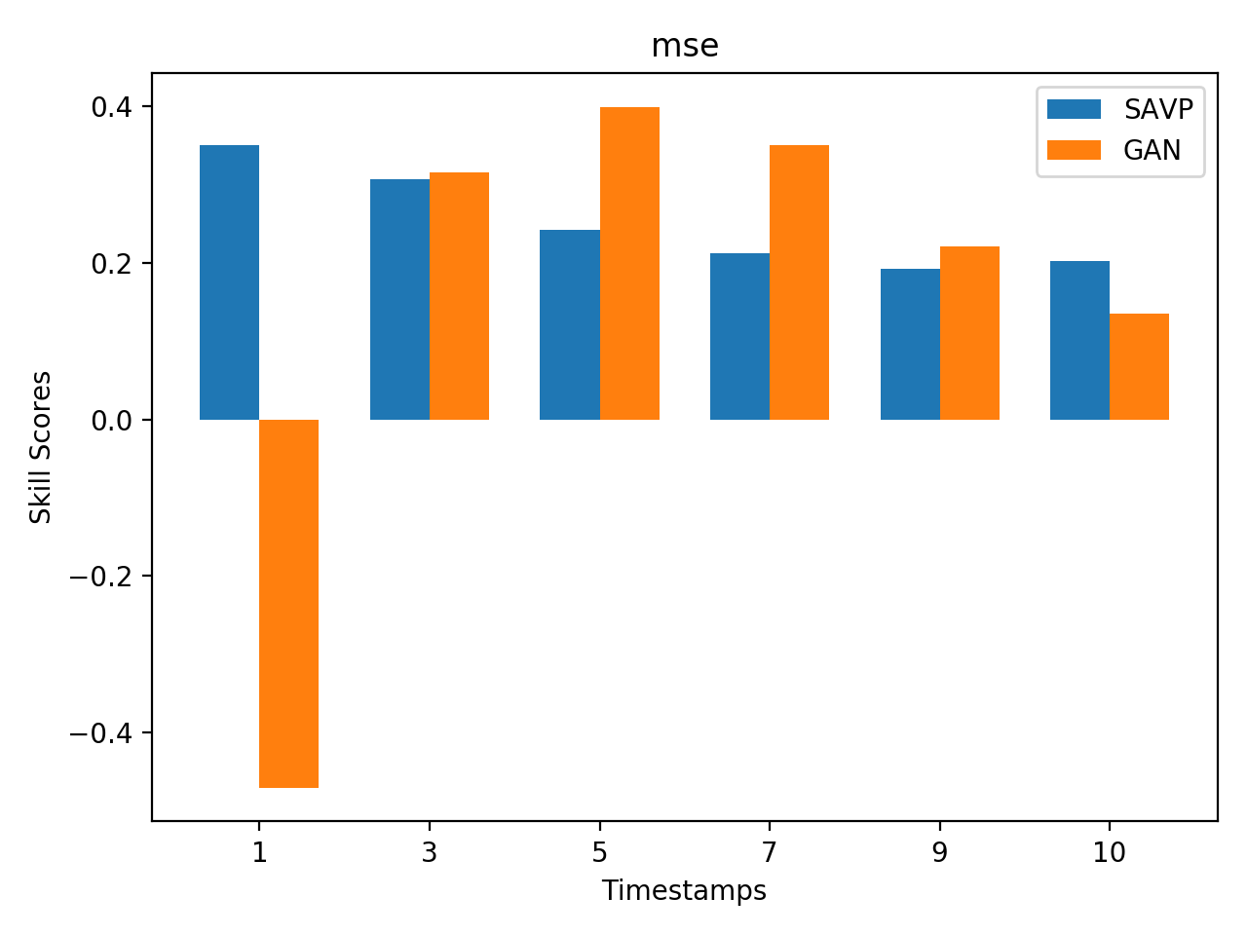
results
GAN, VAE, and SAVP
Data
Extraction
Data
Pre-processing
Training
Figure. Temperature frame prediction performances of the end-to-end trained models SAVP, GAN, and VAE from experiments 1, 5, and 9
Figure. Skill scores of prediction performances from experiments 1, and 5 using experiment 9 as reference
Post-processing
The VAE (experiment 9) is used as reference model.
The results demonstrate that for all models, the accuracy degrades gradually with increasing lead time.
In most cases, SAVP and GAN show positive skill scores, thus indicating that these models outperform VAE. Between forecast steps 3 and 7, the GAN network exhibits the best performance.
back

Slide 23
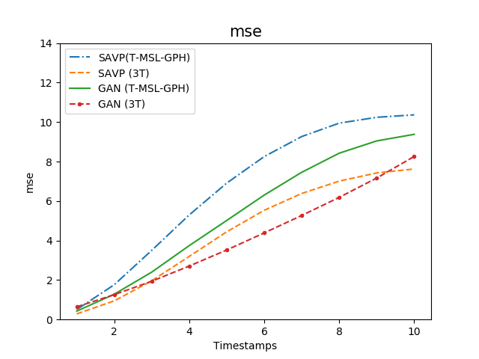
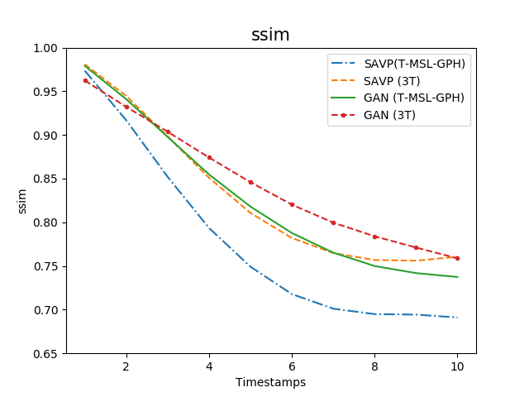
results
Multiple variables VS Identical variable
Data
Extraction
Data
Pre-processing
Training
Comparison of forecast scores from experiments with three duplicated temperature variables (experiments 1 and 5) versus those with three input variables (experiments 2 and 6).
The two additional variables may provide valuable knowledge on general weather conditions.
The networks do not seem to capture the physical relation between the near surface temperature and the large scale flow pattern on these time scales.
Post-processing
back

Slide 24
results
Persistence analysis
2017-10-02 15:00:00- 2017-10-02 24:00:00
Data
Extraction
Ground
truth
Persistence
Data
Pre-processing
SAVP (3T)
Training
We will answer: How much added value is the forecasting model to simply saying that tomorrow will be like today (Marion P. Mittermaier, 2007)
Use the same hour of previous day as forecasting and compare with the SAVP (3T) forecasting.
From the two samples (this slide and next one), the SAVP prediction outperforms persistent temperature.
More cases:
Post-processing
back

Slide 25
outline
Motivation
Deep learning architectures
Parallel deep learning workflow
Experiment settings
Results
Conclusions and outlook

Slide 26
Conclusions and outlook
Application of the state-of-the-art video prediction methods for 2m temperature forecasting over Europe
Deep Learning
Parallel Training
VAE, GAN, and SAVP compared
Transfer learning VS end-to-end training
Multi-variables testing
Persistence analysis
Horovod library can be efficiently employed for parallel training.
Lack of physical constraints
Multiscale in spatial/temporal space/ to catch global and long-term features
Latent space learning to get rid of the Gaussian distribution assumption
☓ Some issues remain with respect to convergence of results

Slide 27

acknowledgement
Funding is provided through ERC Advanced grant ERC-2017-ADG #787576 by Martin Schultz
DeepRain is funded by the Bundesministerium fuer Bildung und Forschung (BMBF),
under grant agreement 01 IS18047A

Slide 28
Thank you

Slide 29

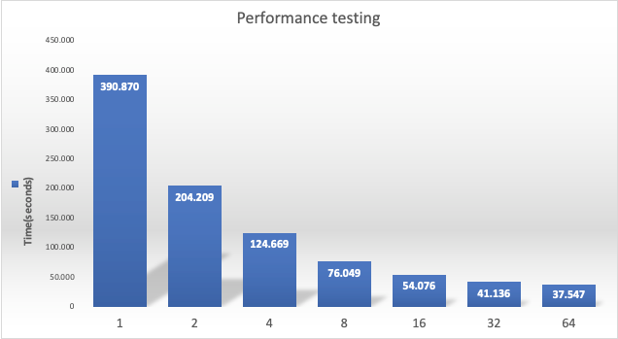

Scalability performance
Parallel training for PredNet on JUWELS (left) from JSC and Piz Daint (right) from CSCS
We carry out the parallel training in light of PredNet architecture for our first try.
We scale the training process from 1 to 20 GPUs on JUWELS system in Jülich supercomputing Center (JSC). We also test this scalability with container technology on a different system – Piz Daint from Swiss National Supercomputing Center (CSCS).
So far, some issues remain with respect to convergence of results, and the parallel training for SAVP is not implemented yet.
PredNet: https://coxlab.github.io/prednet/
back
Notes:
We started a relative simple LSTM based architecture named PredNet
we scale the training process from 1 to 20 GPUs on JUWELS system in Julich supercomputing center. Also we test this scalability on a different system Swish national suptercomputing center with container technology,
The reason for the same scaling performance between 16 to 20 is that. We keep the sampls for each epoch the same for instance 100. and we used the same batchs size which is 20, and we distribute the steps 100/20 to 5 GPUS, so it run the 5 steps inside each epoch paralleliztation, but if we used 6 GPUs. We still the same scalability performance as 5 because we have maxium steps of 5, and one GPU indeed is idle.
steps_per_epoch=samples_per_epoch/(batch_size*hvd.size())

Slide 30
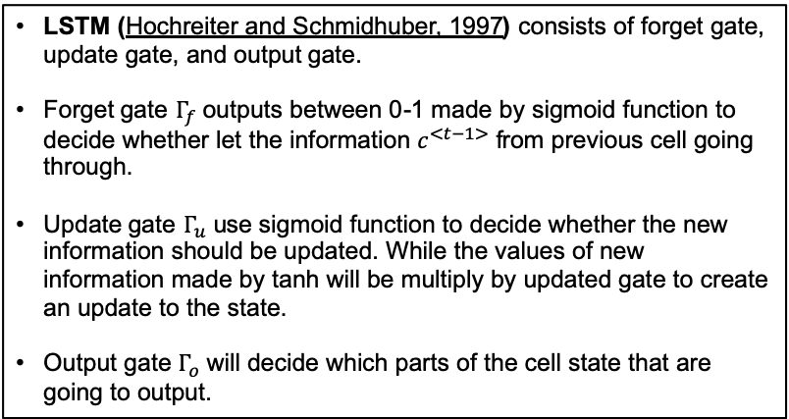
DEEP LEARNING ARCHITECTURES
RNN
RNN (Rumelhart et al. 1985) demonstrates the capability of capture the temporal information of data through connecting previous information to the present.
Traditional RNN fails to reserve the long-term dependencies, leading to gradient vanish (Why? Bengio, 1994)
Cell for
traditional RNN
Architecture of a traditional RNN
LSTM (Hochreiter and Schmidhuber, 1997) consists of forget gate, update gate, and output gate.
Forget gate $Γ_{f}$ outputs between 0-1 made by sigmoid function to decide whether let the information $c^{<t−1>}$ from previous cell going through.
Update gate $Γ_{u}$ use sigmoid function to decide whether the new information should be updated. While the values of new information made by tanh will be multiply by updated gate to create an update to the state.
Output gate $Γ_{o}$ will decide which parts of the cell state that are going to output.
Cell for LSTM
back

Slide 31
DEEP LEARNING ARCHITECTURES
RNN
Cell for convLSTM
convLSTM (Xingjian et al. 2015), performs convolution operator in each LSTM cell.
Studies adopt RNN based architecture: PredRNN (Wang Y,. et al., 2017), MIM (Wang, Yunbo, et al. 2019)
back

Slide 32
DEEP LEARNING ARCHITECTURES
VAE
VAE (Kingma & Welling 2013 ) is an approach to compress the input information from high dimension spaces to lower ones by convolutional layers, Then it reconstructs the original dimension in a generative process way by transposed convolutional layers with constraining the latent space’s distribution resembling a predefined distribution (e.g. Gaussian distribution ).
Studies adopt VAE based architecture: DDPAE (Hsieh, Jun-Ting, et al., 2018)
back

Slide 33
DEEP LEARNING ARCHITECTURES
GAN
The idea of this GAN (Goodfellow et al. 2014) is that, the generator is trained to generate images while the learned discriminator network tries to classify the generated image is real or not.
Studies adopt GAN based architectures: Adv+GDL (Mathieu, et al. 2015), VGAN (Vondrick , et al. 2016), MD-GAN (Xiong , et al. 2018)
back

Slide 34
Experiment settings
Experiment settings
Data
Extraction
Variables:
We use three variables to represent three channels of the frame as input.
3 * Temperature: three duplicated temperature variables
Mode:
End_to_end: perform the entire workflow and use our pre-processed datasets for training.
KTH_pretrained: use pre-trained models on KTH dataset from the study Lee et al. 2018 for the 2m temperature forecasting task.
KTH dataset consists of human six activities: walking, jogging, running, boxing, handwaving, and have clapping. It is a benchmark dataset, which is widely used in video prediction task (Schuldt et al. 2004).
The pre-trained models can be accessed from http://rail.eecs.berkeley.edu/models/savp/pretrained_models
Data
Pre-processing
Training
Post-processing
back

Slide 35
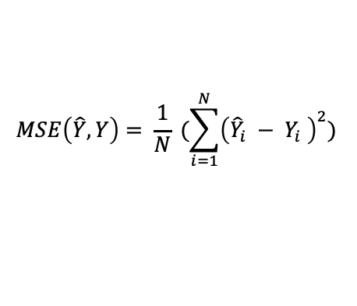
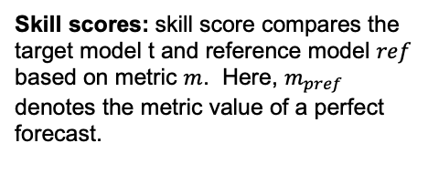
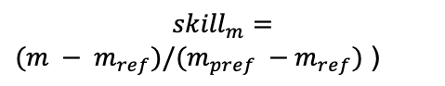
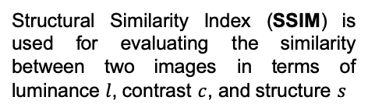
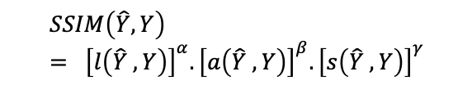
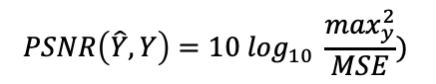
results
Evaluation metrics
Peak Signal to Noise Ratio (PSNR) measures the ratio between the maximum possible power of a signal and the power of corrupting noise that affects the fidelity of its presentation
Structural Similarity Index (SSIM) is used for evaluating the similarity between two images in terms of luminance $l$, contrast $c$, and structure $s$
Data
Extraction
$$PSNR\left(\hat{Y},Y\right)=10 \log_{10} \frac{\max_{y}^{2}}{MSE})$$
$$SSIM\left(\hat{Y},Y\right)= {\left[l\left(\hat{Y} , Y\right)\right]}^{α}.{\left[a\left(\hat{Y} ,Y\right)\right]}^{β}.{\left[s\left(\hat{Y} ,Y\right)\right]}^{γ}$$
Data
Pre-processing
Mean Square Error (MSE) : used
for comparing the difference between two images.
Skill scores: skill score compares the target model t and reference model $ref$
based on metric $m$. Here, $m_{pref}$ denotes the metric value of a perfect forecast.
Training
$$MSE\left(\hat{Y},Y\right)= \frac{1}{N} (\sum_{i=1}^{N}{{\left({\hat{Y}}_{i} − Y_{i} \right)}^{2}})$$
$${skill}_{m}=$$
$(m − m_{ref})/(m_{pref} −m_{ref})$ )
Post-processing
In terms of the PSNR and SSIM, better model performance is associated with higher values, while better MSE scores are smaller values.
back

Slide 36
results
Visualization – SAVP
Data
Extraction
Data
Pre-processing
Training
Post-processing
(C) Diff ( = GT - SAVP ):
The value towards red color means the temperature were underestimated;
The blue color corresponds to the overestimated values.
back

Slide 37
results
Persistence analysis
Data
Extraction
2017-10-03 03:00:00- 2017-10-03 13:00:00
Data
Pre-processing
Training
Figure. Row 1: Ground truth; Row 2: Persistent; Row 3: SAVP Prediction
Post-processing
back

Slide 38
REFERENCES
Lee, Alex X., et al. "Stochastic adversarial video prediction." arXiv:1804.01523 (2018).
Lotter, William, Gabriel Kreiman, and David Cox. "Deep predictive coding networks for video prediction and unsupervised learning." arXiv:1605.08104 (2016)
Wang, Y., Long, M., Wang, J., Gao, Z., Philip, S.Y.: PredRNN: Recurrent neural networks for predictive learning using spatiotemporal lstms. In: Advances in Neural Information Processing Systems. (2017)
Sergeev, Alexander, and Mike Del Balso. "Horovod: fast and easy distributed deep learning in TensorFlow." arXiv preprint arXiv:1802.05799 (2018).
Lee, Alex X., et al. "Stochastic adversarial video prediction." arXiv preprint arXiv:1804.01523 (2018).
Xingjian, S. H. I., et al. "Convolutional LSTM network: A machine learning approach for precipitation nowcasting." Advances in neural information processing systems. 2015.
Wang Y, Long M, Wang J, Gao Z, Philip SY. Predrnn: Recurrent neural networks for predictive learning using spatiotemporal lstms. InAdvances in Neural Information Processing Systems 2017 (pp. 879-888).
Wang Y, Zhang J, Zhu H, Long M, Wang J, Yu PS. Memory In Memory: A Predictive Neural Network for Learning Higher-Order Non-Stationarity from Spatiotemporal Dynamics. In Proceedings of the IEEE Conference on Computer Vision and Pattern Recognition 2019
Schuldt C, Laptev I, Caputo B. Recognizing human actions: a local SVM approach. InProceedings of the 17th International Conference on Pattern Recognition, 2004. ICPR 2004. 2004 Aug 26 (Vol. 3, pp. 32-36). IEEE.
Bengio Y, Simard P, Frasconi P. Learning long-term dependencies with gradient descent is difficult. IEEE transactions on neural networks. 1994 Mar;5(2):157-66.
Click the reference to go back to the slide

Slide 39
REFERENCES
Hsieh JT, Liu B, Huang DA, Fei-Fei LF, Niebles JC. Learning to decompose and disentangle representations for video prediction. InAdvances in Neural Information Processing Systems 2018 (pp. 517-526).
Yan Y, Xu J, Ni B, Zhang W, Yang X. Skeleton-aided articulated motion generation. InProceedings of the 25th ACM international conference on Multimedia 2017 Oct 19 (pp. 199-207).
Kingma DP, Welling M. Auto-encoding variational bayes. arXiv preprint arXiv:1312.6114. 2013 Dec 20.
Hochreiter S, Schmidhuber J. Long short-term memory. Neural computation. 1997 Nov 15;9(8):1735-80.
Goodfellow I, Pouget-Abadie J, Mirza M, Xu B, Warde-Farley D, Ozair S, Courville A, Bengio Y. Generative adversarial nets. InAdvances in neural information processing systems 2014 (pp. 2672-2680).
.
Rumelhart DE, Hinton GE, Williams RJ. Learning internal representations by error propagation. California Univ San Diego La Jolla Inst for Cognitive Science; 1985 Sep
Mathieu M, Couprie C, LeCun Y. Deep multi-scale video prediction beyond mean square error. arXiv preprint arXiv:1511.05440. 2015 Nov 17.
Vondrick C, Pirsiavash H, Torralba A. Generating videos with scene dynamics. InAdvances in neural information processing systems 2016 (pp. 613-621).
Xiong W, Luo W, Ma L, Liu W, Luo J. Learning to generate time-lapse videos using multi-stage dynamic generative adversarial networks. InProceedings of the IEEE Conference on Computer Vision and Pattern Recognition 2018 (pp. 2364-2373).

